Slide 1
STAR COUNCIL

Slide 2
Star Council
Father McGivney Award
Membership Quota
7% of current membership
Or Minimum of 4
Maximum of 35
Service Program Personnel
Report
Form #365
Due – August 1st
Founders’ Award
Insurance Quota
2.5% of current membership
Or Minimum of 3
Maximum of 18
Annual Survey of
Fraternal Activity
Report Form #1728
Due – January 31st
Columbian Award
Report Form #SP7
Due – June 30th
Good Standing
Current with all Supreme Council assessments - as of June 30th of the fraternal year
Multiple Stars
Double Star = 200% Membership
Triple Star = 300% Membership
Four Star = 400% Membership
Five Star = 500% Membership

Slide 3
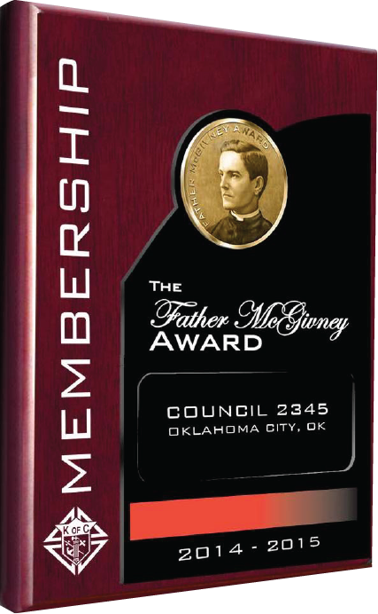
Father McGivney Award
Membership Quota
7% of membership on July 1
Or Minimum of 4 and maximum of 35

Slide 4
Founders’ Award
Insurance Quota
2.5% of membership on July 1
Or Minimum of 3 and maximum of 18

Slide 5
Columbian Award
Application (#SP-7)
Due – June 30th

Slide 6
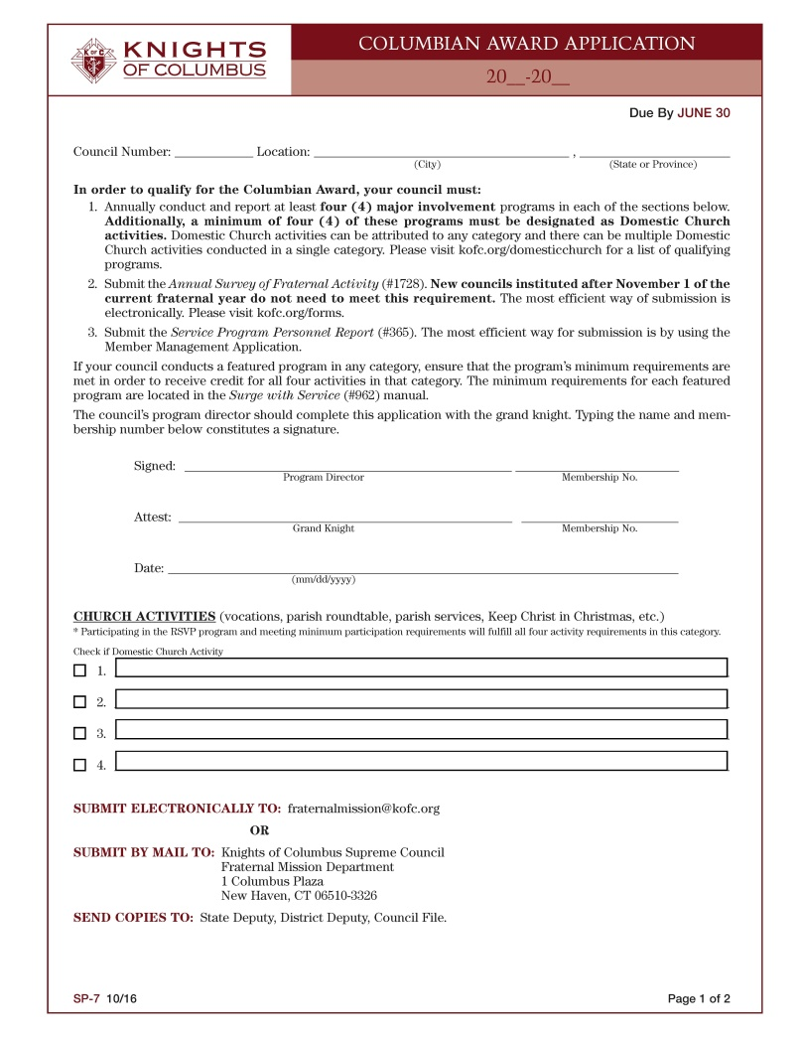
Columbian Award Application
Report Form #SP-7
Due – June 30th

Slide 7
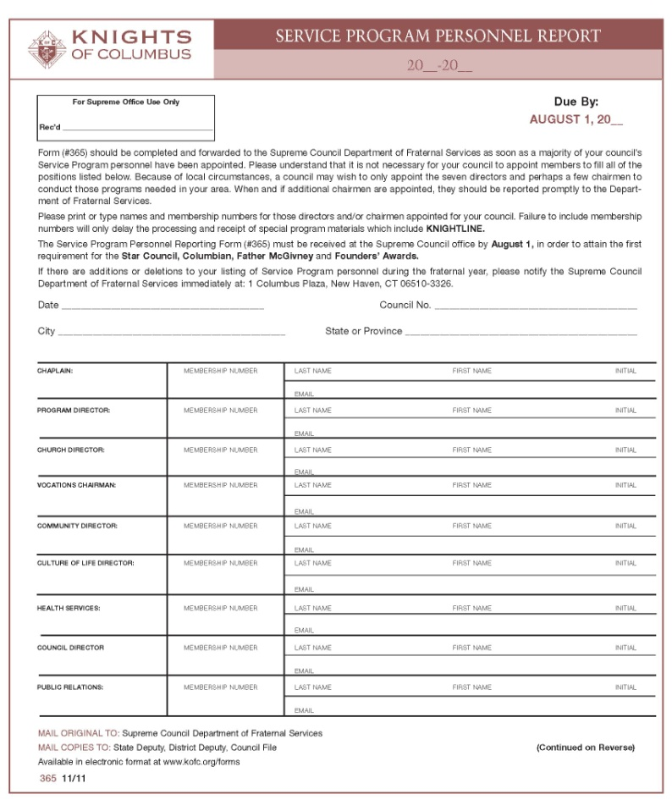
Service Program Personnel Report
Report Form #365
Due – August 1st

Slide 8
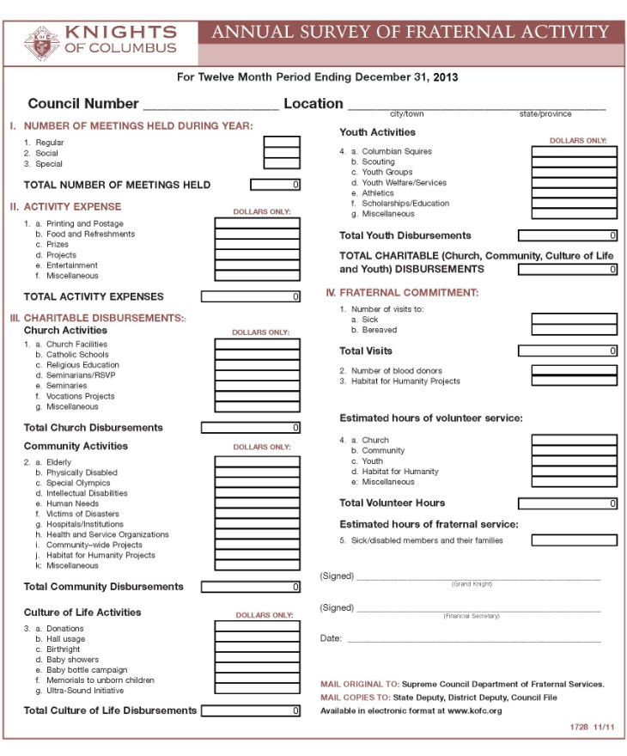
Annual Survey of Fraternal Activity
For Twelve Month Period Ending December 31, 2015
Report Form #1728
Due – January 31st

Slide 9
Good Standing
Current with all Supreme Council assessments
as of June 30th of the fraternal year.

Slide 10
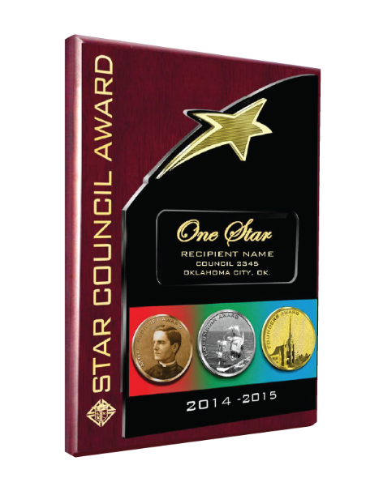
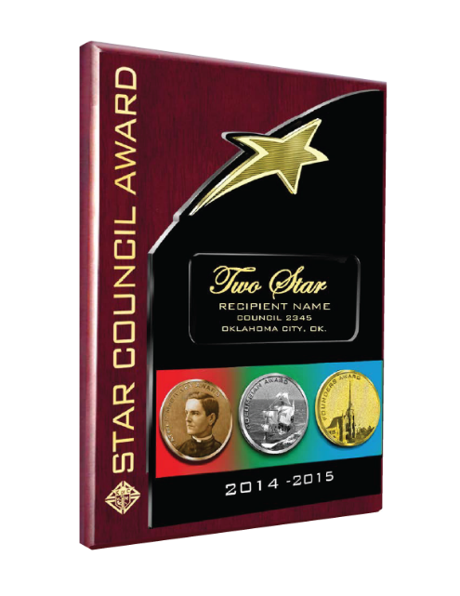
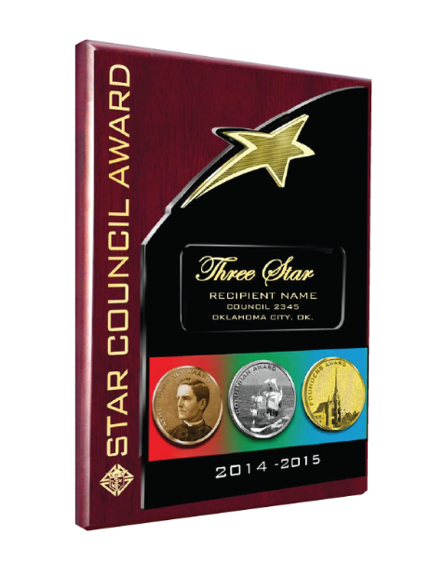
Multiple Stars
Two Star
200% of membership quota
Three Star
300% of membership quota
Four Star
400% of membership quota
Five Star
500% of membership quota

Slide 11
Star Lapel Pins
Grand Knight
Membership Director
Program Director
District Deputies
Agents

Slide 12
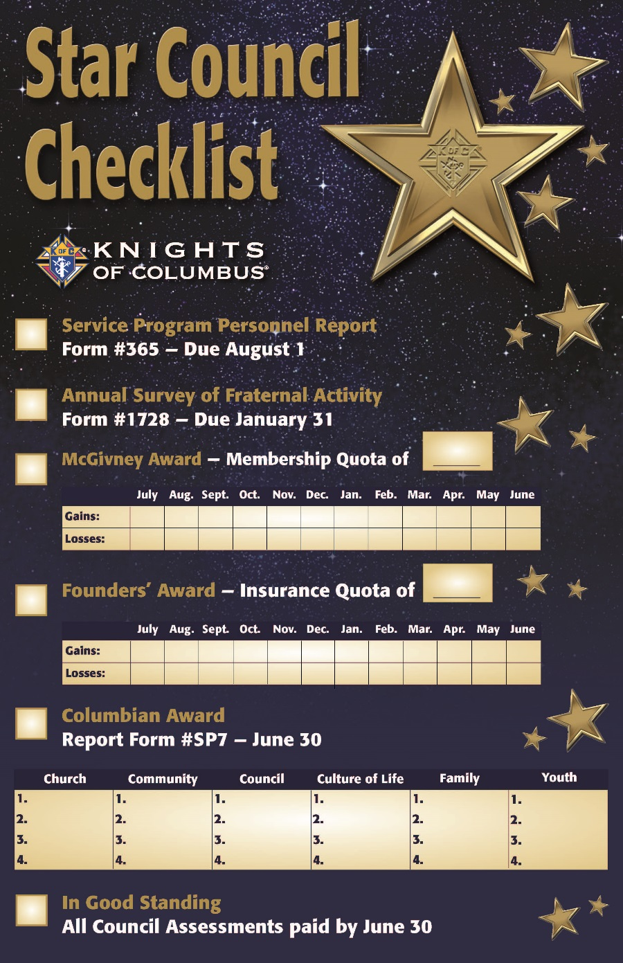
Tracker Tool for Councils

Slide 13
Star Council
Father McGivney Award
Membership Quota
7% of current membership
Or Minimum of 4
Maximum of 35
Service Program Personnel
Report
Form #365
Due – August 1st
Founders’ Award
Insurance Quota
2.5% of current membership
Or Minimum of 3
Maximum of 18
Annual Survey of
Fraternal Activity
Report Form #1728
Due – January 31st
Columbian Award
Report Form #SP7
Due – June 30th
Good Standing
Current with all Supreme Council assessments - as of June 30th of the fraternal year
Multiple Stars
Double Star = 200% Membership
Triple Star = 300% Membership
Four Star = 400% Membership
Five Star = 500% Membership

Slide 14
STAR COUNCIL

